Slide 1
Computational Science An Industrial Perspective Workshop Multiscale Modeling for the Development of Commercial Materials and Devices
Dr. Edward Furlani
Dept. of Chemical and Biological Engineering Dept. Electrical Engineering

Slide 2

Interdisciplinary Computational Research
Academic Research: SUNY at Buffalo (2011 - present )
Prof. Chemical and Biological Engineering
Prof. Electrical Engineering
Industrial Research: Eastman Kodak Research Labs (1982 – 2010) Computational modeling for commercial product development.
Research Areas
Nanophotonics: plasmonics, photothermal phenomena, metamaterials
Computational fluid dynamics (CFD): multiphase systems, heat/mass transfer, nanofluids, ink jet systems
Microfluidics: devices and processes, design and simulation
Computational Magnetics: Directed self-assembly, bioseparation, drug delivery
MOEMS/MEMS: design and simulation
Dr. Edward Furlani (efurlani@buffalo.edu)
Notes:
Prof. Furlani has joint appointments in the Depts. of Chemical and Biological Engineering and Electrical Engineering. His research involves multidisciplinary/multiscale modeling with an emphasis on the development of novel materials and devices. Current projects include:
Development of microfluidc–based optical biosenors
Development of polymer-based metamaterials using laser writing techniques.
Analysis of plasmon-enhanced photothermal energy conversion with an emphasis on cancer therapy.
Development and application of hybrid magneto-plasmonic nanostructures for biomedical applications such as targeted drug delivery and photo-induced hyperthermia.
Development of magnetic nanoparticle enhanced Surface Plasmon Resonance based biosensors. The magnetic particles enable accelerated field-directed trapping of the target biomaterial on the sensing element.

Slide 3
Presentation Overview
Introduction
Modeling Overview
Kodak Materials and Micro-Device Research
Micro-Optical Electro-Mechanical Devices
Microfluidics: Inkjet Technology
Summary

Slide 4
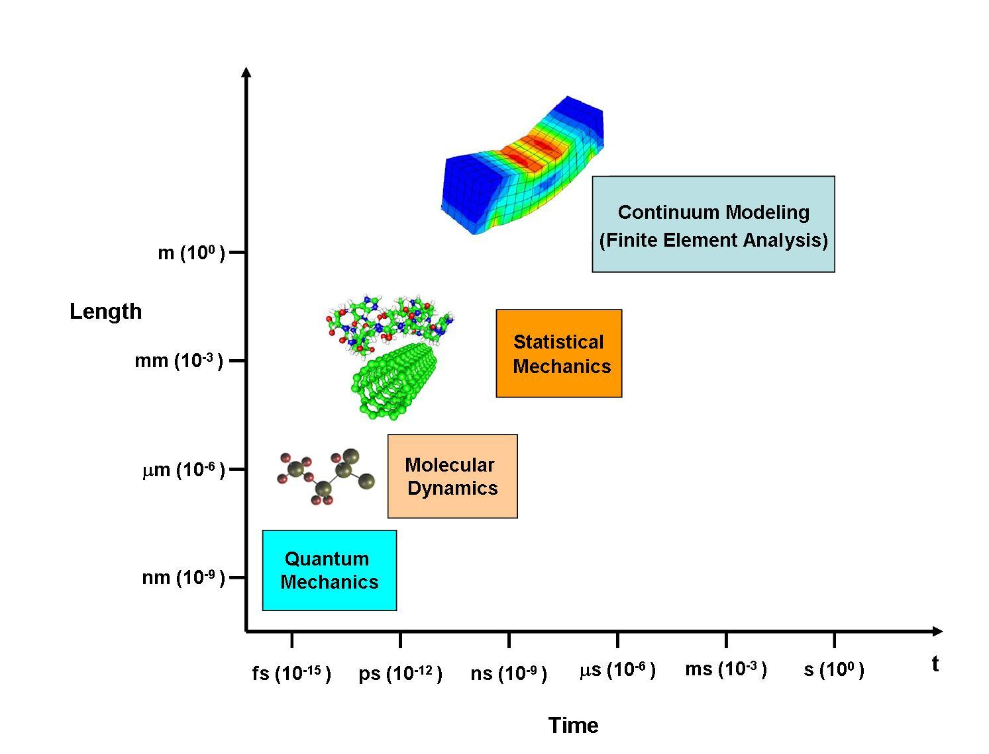
Multiscale Modeling
Modeling Phenomena Across Multiple Length and Time Scales

Slide 5
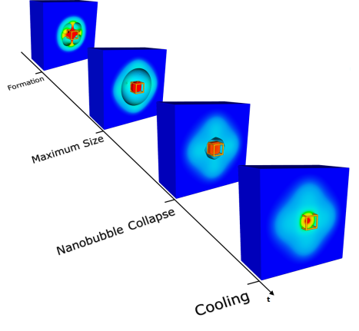
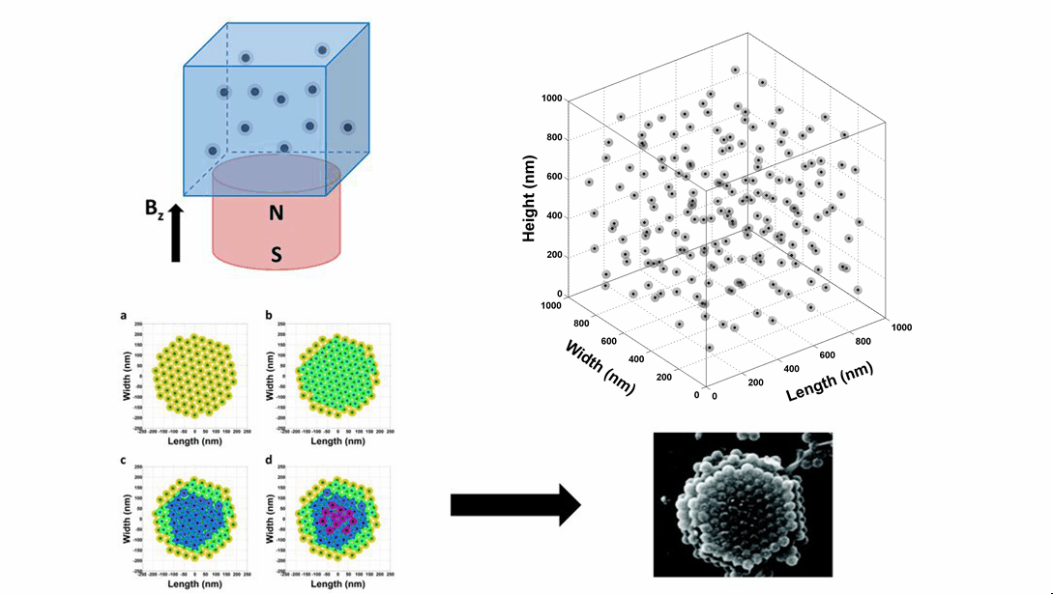
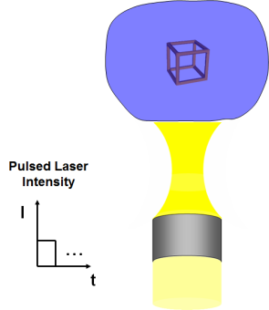
Interdisciplinary Computational Research
Computational Electromagnetics
& Photonics
Computational Fluid Dynamics & Microfluidics
EM Fluid Properties
EM Nanoparticle
Properties
Particle- Fluid Interactions
Nanofluids
Mass Transport & Self-Assembly
Plasmonic Photothermal Phenomea
Nanomagetics Self-assembly

Slide 6
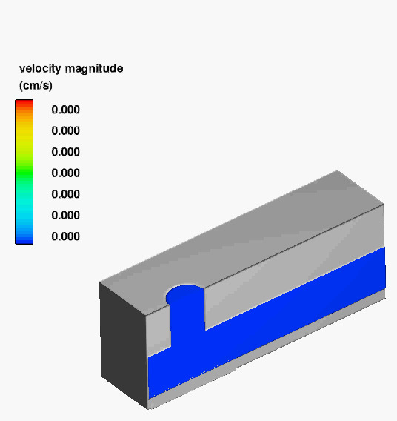
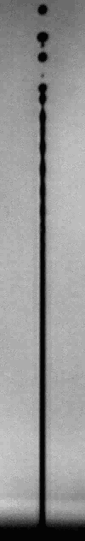
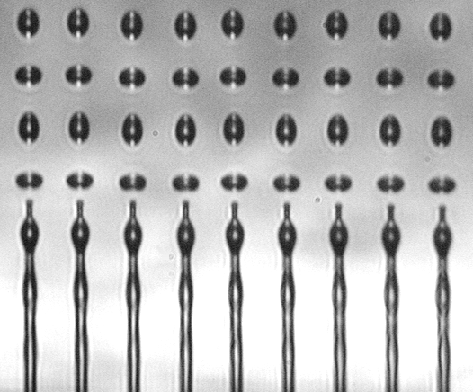
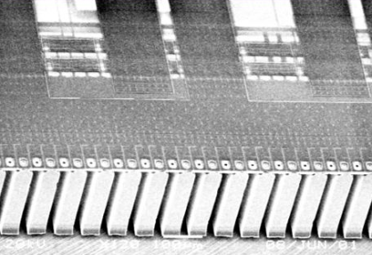
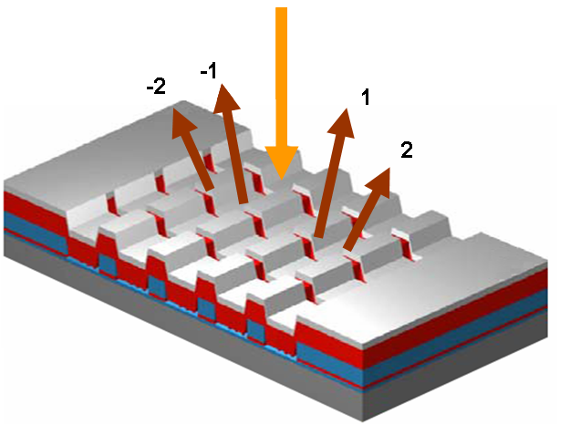
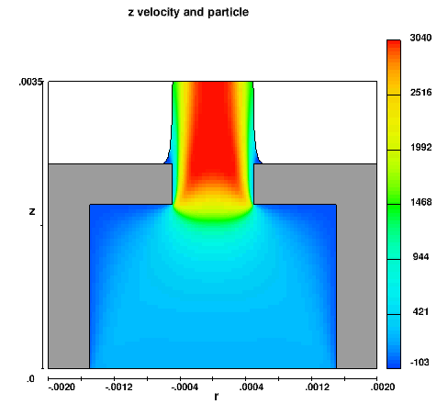
Modeling Overview
Inkjet Printing
Inkjet Printing
Microfluidics
InkJet
Micro Nozzle Array
Micro-Optical
Electro-Mechanical
Devices
Nanofluids Mass Transport
MEMS Light Modulator
Nanofluids
Pigment
60 nm

Slide 7
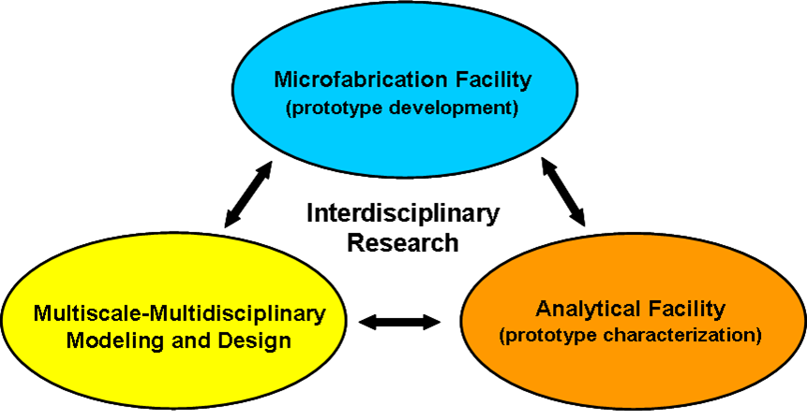
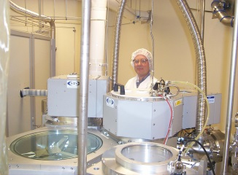
Kodak Materials & Microdevice Research
Clean Room Prototype Fabrication $50-200K per Design Cycle 1-3 Month Turn Around
Interdisciplinary Research Team
(4-12 Contributors)
Concept Development Performance Metrics
Intellectual Property
Fundamental Modeling & Design
Fabrication & Characterization
Commercialization
Notes:
7

Slide 8

Materials & Microdevice Research
In House Prototype Development Facility 12,000 sq ft Class 100/1000 Clean Room
Processing: 6” (150mm) Si wafers
Resolution: 0.5µm features
Full CMOS* Integration
Clean/Wet Etch
Megasonics cleaner
Spin spray rinser/dryer
Deposition
CVC sputterer
LPCVD furnace
PEO annealing furnace
Lithography
Canon stepper
Spin coater
Polyimide/PMDS ovens
Dry Etch
Oxford etcher
Dielectric Etch
STS
STS cluster tool
Wafer grinder
Analytical
Ellipsometer
Reflectrometer
SEM
Profilometer
*CMOS = Complementary Metal–Oxide–Semiconductor

Slide 9
Micro-Optical Electro-Mechanical Devices
Kodak MEMS Light Modulator
Micromachined Reflection Grating
115 in Front Projection Display
L ≈ 100 μm
W ≈ 50 μm
Motivation: Solid State Display Applications

Slide 10
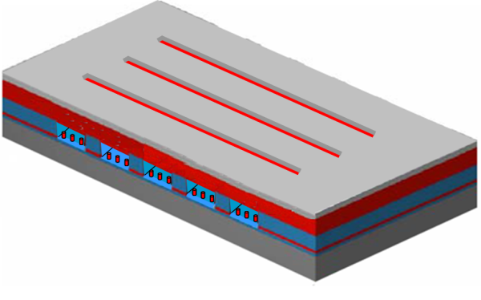
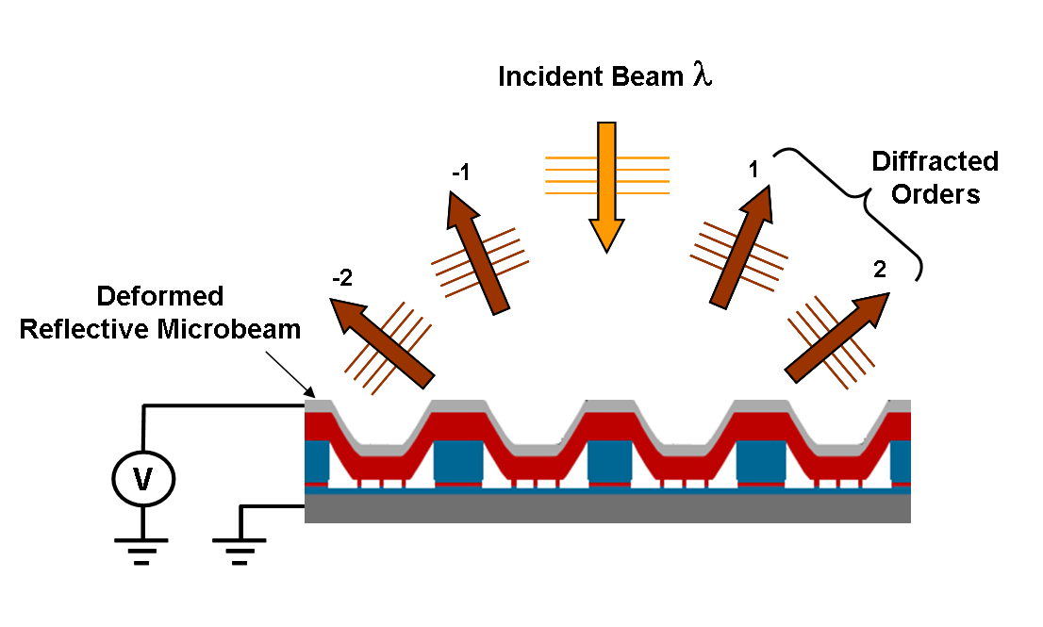
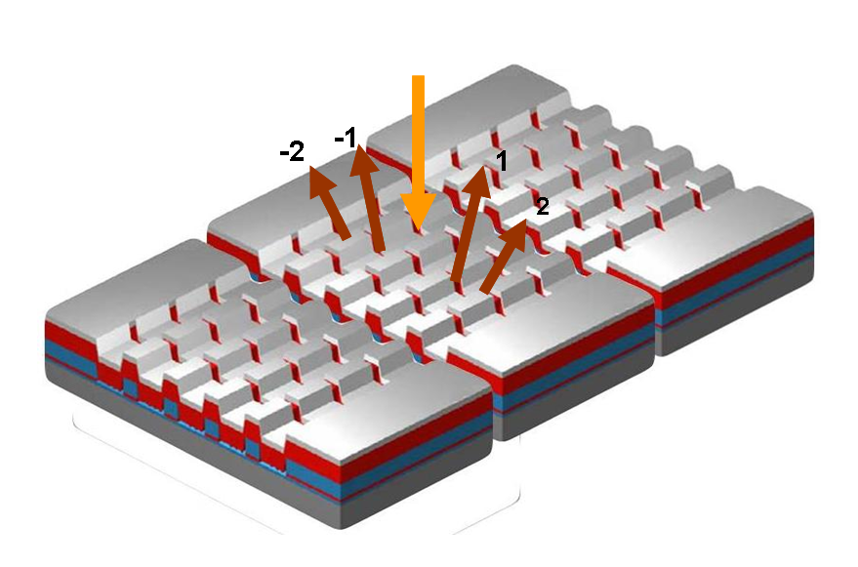
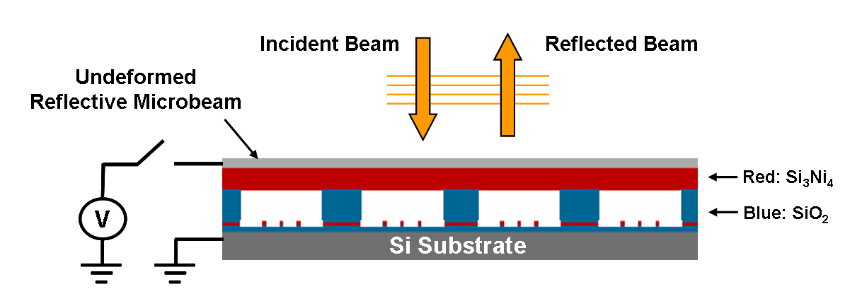
Micro-Optical Electro-Mechanical Analysis
Modeling and Device Design
Off Pixel
Kodak GEMS* Technology (Grating Electromechanical System)
On Pixel
Linear Pixel Array
Off Pixel
L ≈ 100 μm
W ≈ 50 μm
On Pixel
*M. Kowarz, Spatial light modulator with conformal grating device, US. Patent 6307663, 2001.

Slide 11
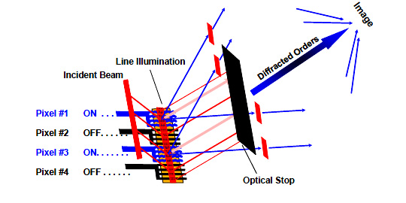
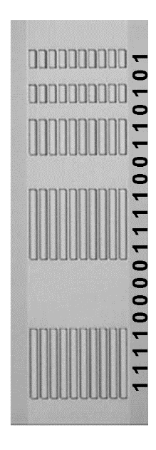
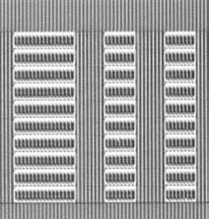
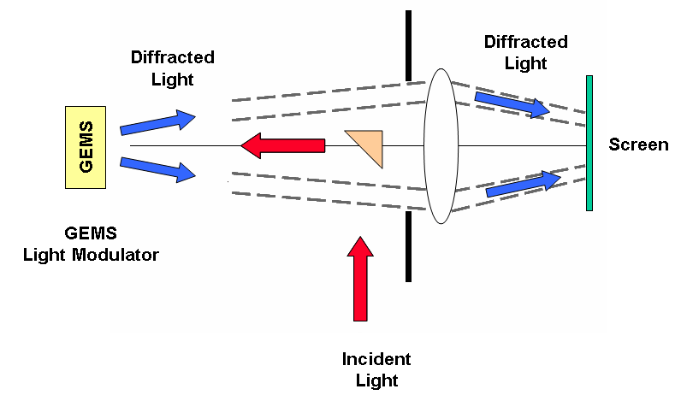

Display Applications: Linear Array Operation
GEMS Light Modulator
Enlarged View 20 Pixels
Pixel #1 ON
Pixel #2 OFF
Pixel #3 ON
Pixel #4 OFF
Pixel #5 ON
Pixel #6 ON
Enlarged View 6 Pixels

Slide 12
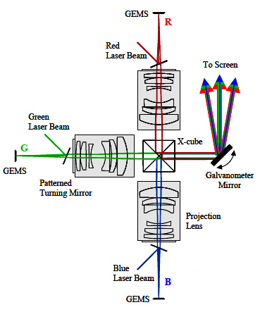
Commercial Projection Display
Front Projection System
Photograph of Scene from Scanned Motion Picture Film
Applications
Front projection Systems
Rear projection laser TV
Heads-up displays
Laser Printing
115 in Front Projection Display
GEMS
Galvanometer Mirror
GEMS
X-cube
GEMS

Slide 13
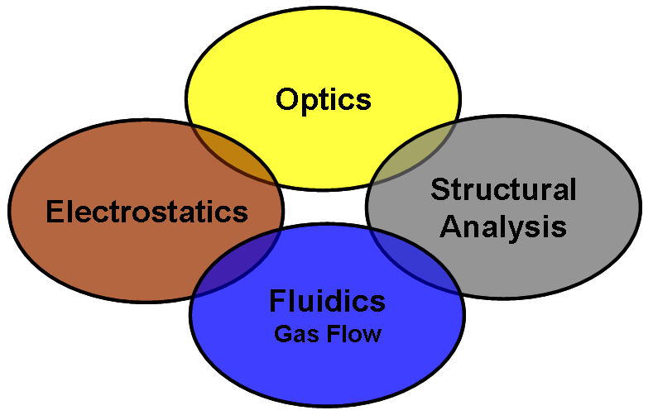
Device Analysis and Rational Design
Off Pixel
L ≈ 100 μm
W ≈ 50 μm
On Pixel
Operating Voltage?
Microbeam Deformation Profile?
Diffraction Efficiency?
Dynamic Response of Microbeam?

Slide 14
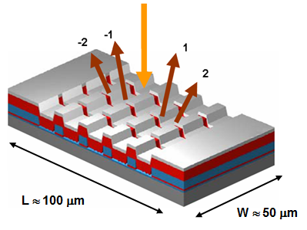
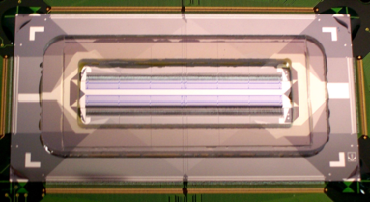
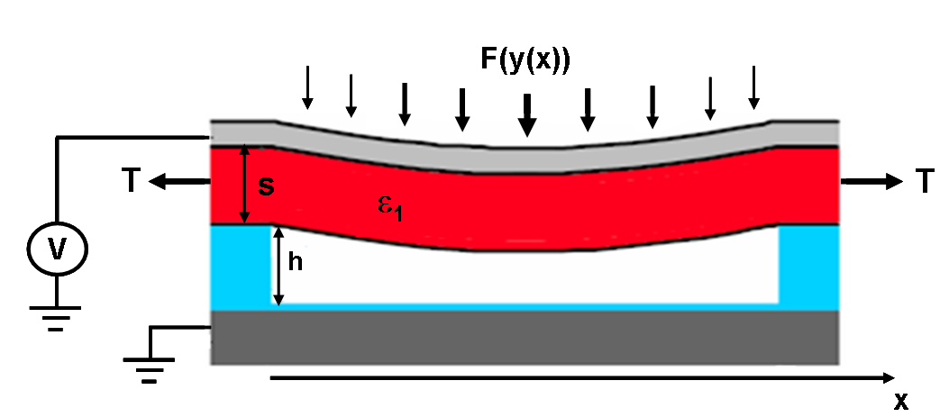

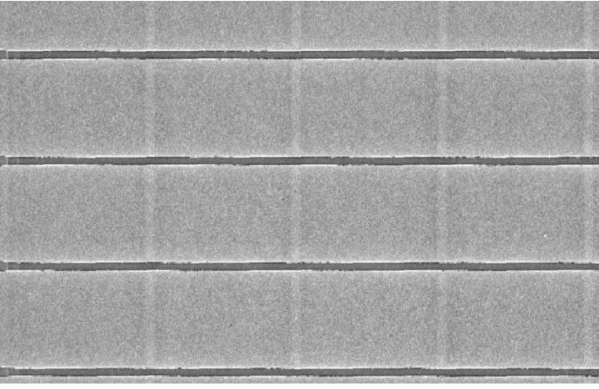
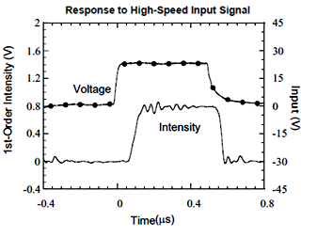
Length and Time Scales
Length
Time
Mesoscale (mm)
200 nm
Si₃Ni₄
Microscale
Microbeam Response Time = 30 ns
20 μm
30 ns
200 nm
Nanoscale
150 - 200 nm
SEM: Gap Beneath Microbeam
Mean free path of air molecules beneath microbeam = 65 nm!

Slide 15
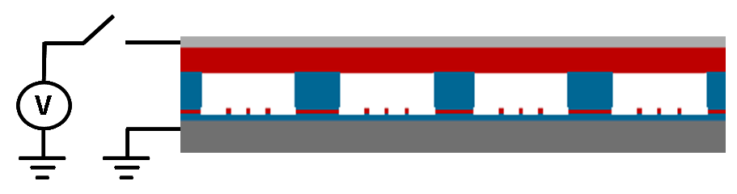
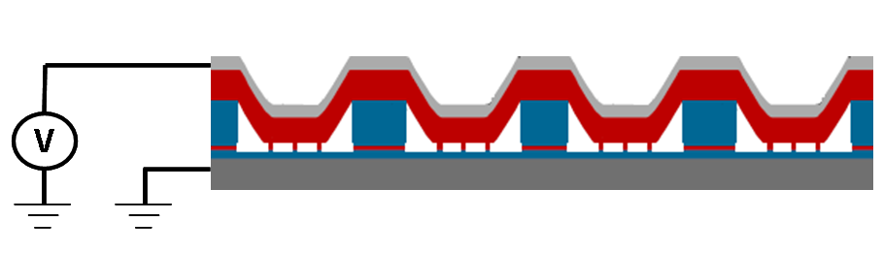
Electrostatic Deformation of Microbeam
Si₃Ni₄
Predict
Deformation Profile vs. Activation Voltage
Nonlinear Electrostatic Force per Length
Pull-In Voltage
T = Tensile Force in Si₃Ni₄ E = Young's Modulus I = Moment of Inertia

Slide 16

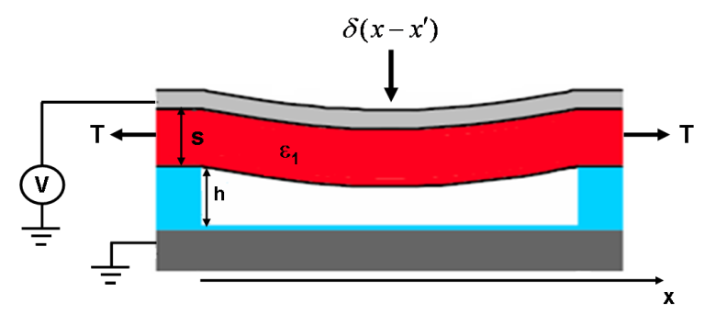
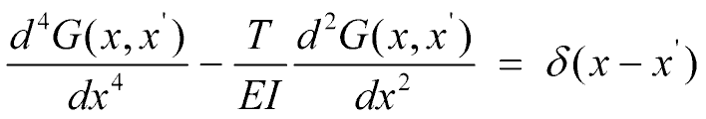
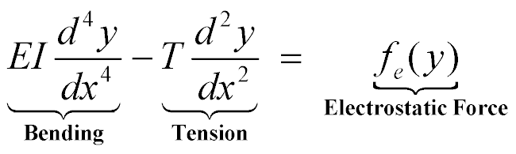
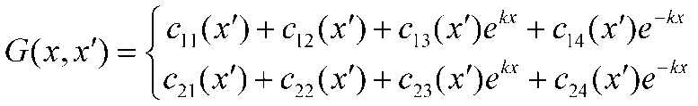
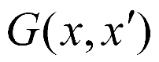
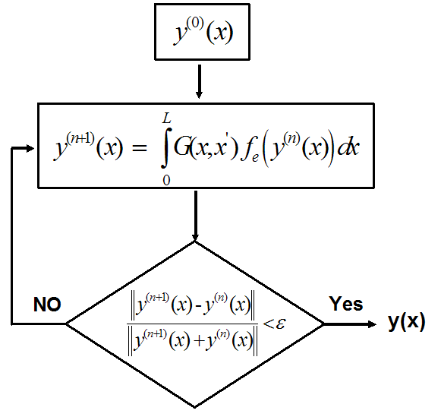
Predict Deformation of Microbeam
Self-Consistent Green’s Function Analysis*
Nonlinear ODE
Boundary Conditions
A
C
B
*E. P. Furlani, Analysis of grating light valves with partial surface electrodes, J. Appl. Phys. 83 1998.

Slide 17
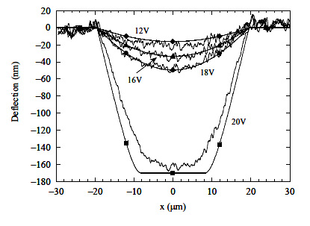
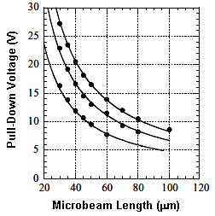
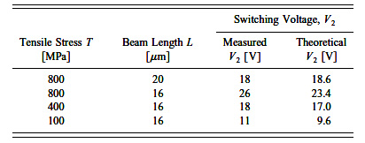
Microbeam Deformation: Model vs. Experiment
Predicted Microbeam Profile y(x) vs. AFM
y(x)
Activation Voltage: Theory vs. Experiment
Optimization
E. P. Furlani, Analysis of grating light valves with partial surface electrodes, J. Appl. Phys. 83 1998

Slide 18
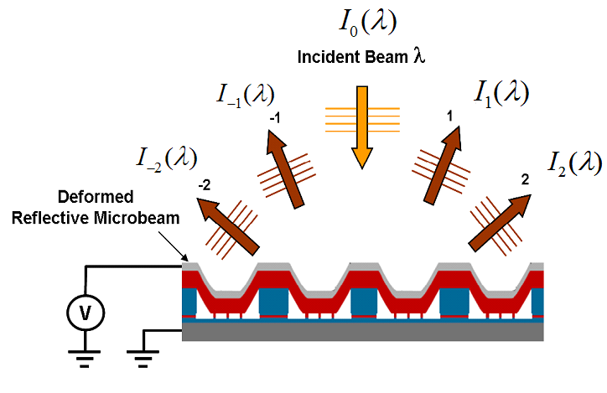
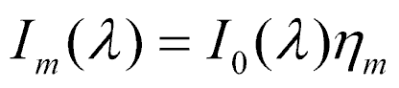
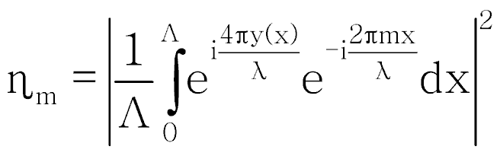
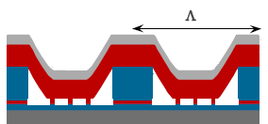
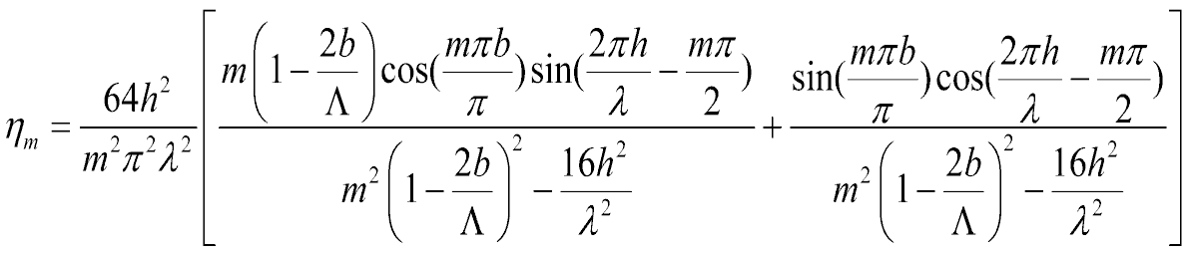
Optical Diffraction Efficiency
Scalar Diffraction Theory
Diffraction Efficiency
y(x)
Trapezoidal Microbeam Profile
x

Slide 19
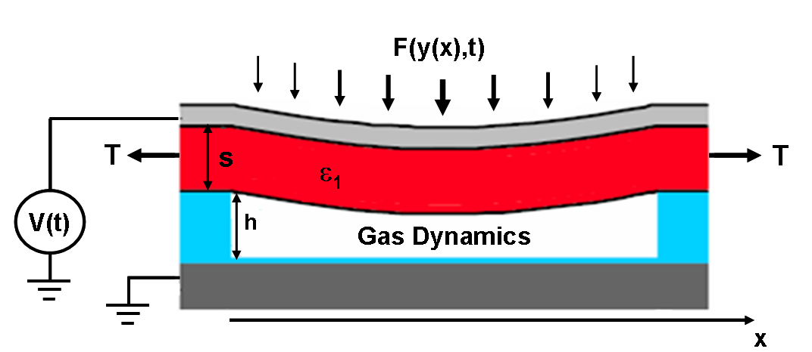
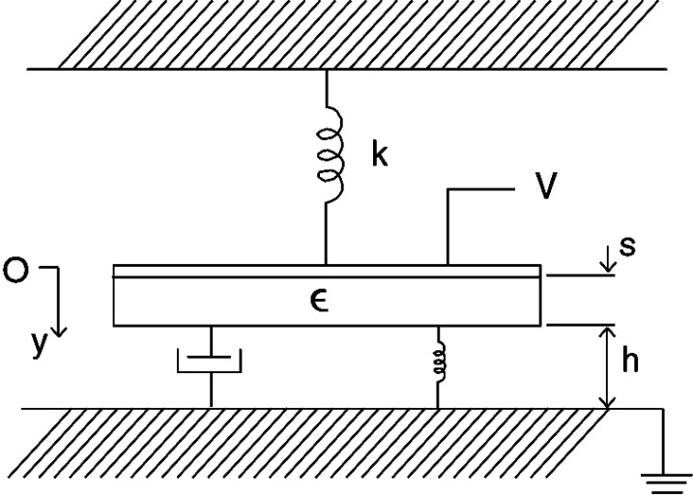
Dynamic Analysis
Coupled Electrostatic/Structural/Gas Flow Analysis
Lumped-Element Model Damped Spring/Mass System
Continuum Model
Coupled Structural Analysis & Gas Dynamics
Spring
Bending & Tension
Gas - Damping & Compression
Coupling: Gas Flow Influences Microbeam Dynamics

Slide 20

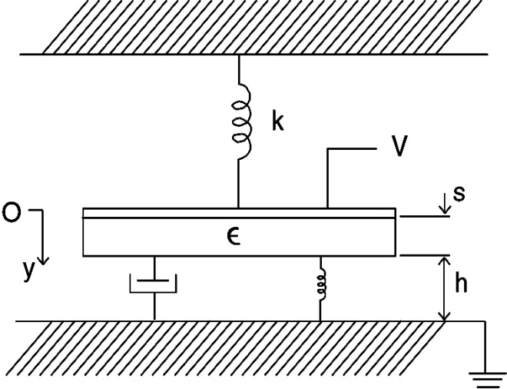
Continuum to Lumped-Element Model
Continuum Analysis y(x) = displacement along microbeam
Lumped-Element Model Damped Spring/Mass System
Spring
Bending & Tension
Lumped-Element Analysis y = displacement of midpoint of microbeam
Gas - Damping & Compression
E. P. Furlani, Theory and simulation of viscous damped reflection phase gratings, J. Phys. D: Appl. Phys. 1999.

Slide 21
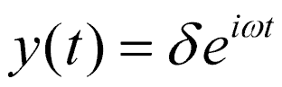
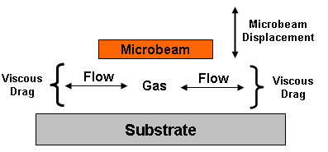
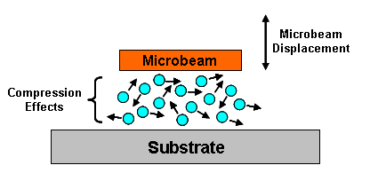
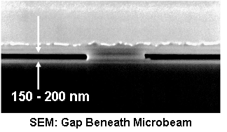




Lumped-Element Dynamic Analysis
Time Harmonic Analysis
Gas Damping
Gas Compression
Linearized Reynolds Equation (Compressible Gas)
Effective Viscosity
Mean free path of air molecules beneath microbeam ≈ 65 nm!
Knudsen number
E. P. Furlani, Theory and simulation of viscous damped reflection phase gratings, J. Phys. D: Appl. Phys. 1999.

Slide 22

Effective Modeling Parameters
Applied Voltage
V(t)
ω₀ = fundamental frequency
ω₁ = first harmonic
t

Slide 23


Lumped-Element Model vs. Experiment
Prediction of Diffraction Intensity into 0'th Order vs. Applied Voltage
Applied Voltage
Diffraction Intensity (Experiment)
Diffraction Intensity (Theory)
0’th Order Diffraction Intensity
Applied Voltage
E. P. Furlani & M. Kowarz, Optical Data Modulation System with Self-damped Electromechanical Conformal Grating, US Patent, 2002.

Slide 24
Summary
Off Pixel
L ≈ 100 μm
W ≈ 50 μm
On Pixel
Operating Voltage
Microbeam Deformation Profile
Diffraction Efficiency
Dynamic Response of Microbeam

Slide 25


Microfluidics: Inkjet Printing
Drop-on-Demand (DOD) Printing
Continuous Printing
30,000 Drops Generated per sec from each Nozzle
500,000 Drops Generated per sec from each Nozzle
Motivation
Microfluidic-based Printing: Most Successful Microfluidic Application ($50-100B)
Notes:
25

Slide 26

Microfluidics: Inkjet Technology
Drop-on-Demand (DOD) Printing
Continuous Printing
Micro Nozzle Array
Notes:
26

Slide 27

Fluid Dynamics and Transport Phenomena
Fluid Dynamics
Thermal Analysis
Thermal Properties of Fluids
Constitutive Relation
Particle/Fluid Interactions (Nanofluids)
Thermal Effects of Fluid Constituents
Mass Transport
Diffusion & Advection of Molecules/Nanoparticles

Slide 28










Historical Contributions to Fluid Mechanics
Archimedes
(C. 287-212 BC)
Newton
(1642-1727)
Leibniz
(1646-1716)
Bernoulli
(1667-1748)
Euler
(1707-1783)
Navier
(1785-1836)
Stokes
(1819-1903)
Reynolds
(1842-1912)
Prandtl
(1875-1953)
Taylor
(1886-1975)

Slide 29
Hydrodynamics
Governing Equations based on the Laws of Physics
Conservation of Mass (ρ = fluid density, u = fluid velocity).
Newton’s Second Law: the change of momentum equals the sum of forces (p = pressure, µ = viscosity, f = external force density).
Conservation of Energy - First Law of Thermodynamics (T= fluid temperature)
Notes:
We treat all properties as averages over a suitably large number of molecules.
A small element of fluid, a fluid particle or fluid point, is the smallest element of fluid
whose macroscopic properties are not influenced by individual molecules.

Slide 30


Navier-Stokes Equations
Newton’s Second Law: change of momentum equals the sum of forces (p = pressure, µ = viscosity, f = external force density).
Claude Navier
1785-1836
Georges Stokes
1819-1903
3D Cartesian Coordinates
Local Acceleration
Convection
Pressure gradient
Viscous terms
The Navier Stokes equations are very difficult to solve analytically because they are non-linear. Analytical solutions exist for few albeit very important cases such laminar flow through regularly shaped conduits!

Slide 31
Numerical Approach to Solving PDEs
Governing Equations ICS/BCS
System of Algebraic Equations
Equation (Matrix) Solver
Approximate Solution
Discretization
Continuous Solutions
Finite-Difference
Finite-Volume
Finite-Element
Spectral Methods
Boundary Element
Discrete Nodal Values
Tridiagonal
ADI
SOR
Gauss-Seidel
Conjugate gradient
Gaussian elimination
u_{i} (x,y,z,t)
p (x,y,z,t)
T (x,y,z,t)

Slide 32

What is Computational Fluid Dynamics (CFD)?
Computational fluid dynamics (CFD) is the science of predicting the behavior of fluid flow and related transport phenomena, e.g. heat transfer, chemical kinetics etc., by solving the governing equations using numerical methods.

Slide 33


CFD Modeling Cycle
Device Concept Develop CAE Model
Piston Driven Droplet Generation
Governing Equations Discretization - Mesh Generation
Algebraic System
of Equations
Choose Solution Algorithm
Solution and Post Processing Data Analysis - Interpretation
Computational Mesh
Notes:
33

Slide 34

CFD Program Solution Cycle

Slide 35
CFD Analysis Applied to Inkjet Printing
Inkjet Printing Methods (DOD & CIJ)
Phase Change Simulation
Thermal-Fluidic & Free-Surface Analysis
Droplet Generation
Marangoni-Assisted Jet Instability
Particle-Fluid Interactions
Aerodynamic Analysis
Nanofluids
Fluid-Surface Interactions
Notes:
35

Slide 36
Microfluidic-based Printing
Drop-on-Demand (DOD) Printing
Continuous Printing
30,000 Drops Generated per sec from each Nozzle
500,000 Drops Generated per sec from each Nozzle
Notes:
36

Slide 37





Emerging Microfluidic Printing Applications
Photovoltaics
Fuel Cells
Batteries
Flex circuits
Smart Textiles
PCB Photomasks
Interconnects
Flat Panel Display
PLED
LCD
Color filters
Flexible displays
RF- ID
Antennas
Printed Circuit Boards
Smart Packaging

Slide 38



Coating of Stents
Stent - fabricated from metals/alloys/polymers and surface treated with materials that reduce the rejection mechanisms.
Current coating methods: dipping, ultrasonic spray coating, painting (air brush), and deposition along the struts using syringes.
Ink-jet based Stent coating

Slide 39





Multiphase Computational Fluid Dynamics (CFD)
Tracking an Interface
Lagrangian Methods (Adaptive Grid)
Eulerian Methods (Fixed Grid)
Volume of Fluid (VOF) Method*

Slide 40


Drop-on-Demand Printing Thermal Bubble Jet
Orifice
Pressure Chamber
Ink
Heater
V(t)
Vapor Bubble
τ ≈ 250 ns
…
τ
Heater pulse duration
0
t
Notes:
40

Slide 41
Printing Cartridge - Thermal Bubble Jet
FILTER
LID
FLAT CABLE
INK “RETAINER”
ADHESIVE
TRANSFER
SEALING GLUE
ACTUATOR GROUP
INK TANK
Ink Drop
PROTECTIVE GLUE
Nozzle Plate
Vapour Bubble
Protective Layer
Hydraulic circuit
Silicon Substrate
Thin Film Heater

Slide 42




Kodak MEMS Thermal Bubble Jet Drop Ejector
Voltage Applied to
Ta-Si-N Heater Layer
Ink
Ta
V(t)
Silicon Nitride
Ta-Si-N
Ta-Si-N Heater Layer < 0.1 μm
…
Silicon Oxide
Silicon
Heater pulse duration: τ ≈ 250 ns
0
τ
t
Notes:
42

Slide 43




Thermal Bubble Jet Drop Ejection: Model vs. Experiment
3D CFD Phase Change Analysis
Homogeneous Bubble Nucleation & Free-Surface Tracking
Quad-Core Workstation 2.8 GHz Processors Windows XP 32 Bit
Simulation Time = 24 Hrs
Flow 3D - VOF Solver
Notes:
43

Slide 44
CFD Thermal Bubble Jet Simulation
Predicted Volume 6.8pl
Predicted Velocity 16.5m/s
Power is applied to a thin film resistive heater.
Fluid adjacent to the heated structure reaches its superheat limit and a vapor bubble form.
The bubble expands rapidly, driving fluid through the orifice causing a droplet to be expelled.
As the vapor bubble expands, a thin layer of superheated fluid which feeds the vapor bubble is depleted, causing the bubble growth to slow, and eventually collapse.

Slide 45






DOD Simulation vs. Experiment

Slide 46

Understanding Air Entrapment - Moving Bubbles
Trapped Air Bubbles

Slide 47

Moving Bubbles
Moving Bubble

Slide 48

Moving Bubbles
Moving Bubble

Slide 49


Bubble Movement (3D CFD)
Contact Angle = 90 deg
Contact Angle = 135 deg

Slide 50



Kodak Stream Technology
Commercial Printer
Image Quality
Prints 8x11in Full Color Image in 1 ms
2400 Times Faster Than Home Printer*
Printer
Moving Substrate (500-1000 ft/min)
Micro Nozzle Array
60 nm
Colored Pigment Nanoparticles
*Assumes 25 color pages printed per minute
Notes:
What could be considered the third generation of CIJ, called Stream technology represents a revolutionary jump in CIJ. You have unparalled speed at offset-class image quality.
The ability to not only print on the usual types of bond papers but to print on coated glossy papers with excellent image quality.
Actual output from a technology demo at drupa 2008 is shown on coated glossy stock
The arrays can be scaled to nearly any length and the high reliability and availability that CIJ has been known for is maintained.

Slide 51


Thermally Induced Microdrop Generation
Heater Embedded in Nozzle
Micro Nozzle Array
J. M. Chwalek, et al. Phys. of Fluids 14, 37-40, 2002

Slide 52




Kodak CMOS/MEMS Array Microdrop Generator
Orifice Diameter = 10 µm
Array of Nozzles
Heater Cross-section
Ink Feed Channels
Orifice
300 µm
Ink inlet
30 µm
Ink channels etched into a CMOS wafer

Slide 53



CFD Analysis of Microdrop Generation
Coupled Thermal-Fluidic & Free-Surface Analysis*
Quad-Core Workstation 2.8 GHz Processors Windows XP 32 Bit 8 GB RAM
Simulation Time = 36 Hrs
V(t)
τ
…
0
t
*FLOW 3D - VOF Solver

Slide 54




Microdrop Generation: Model vs. Experiment
No Fitting Parameters!
Strobbed Image of Drop Formation
CFD Simulation
20 μm
Fluid = H₂O
Simulation Time = 36 Hrs
Too Long for Design and Optimization of Devices!

Slide 55

Length and Time Scales
Length
Time
Paper
cm
Nozzle Array
τ = 250-350 μs
Drop to Paper L = 5-7 mm
V = 20 m/s
mm
Microjet
Jet Break Up L = 600-1000 μm
20 μm
Drop
Volume = 3.5 pl 10⁶ particles
τ = 30-50 μs
f = 500 kHz
60 nm
τ = 2 μs
Colored Pigment Nanoparticles
Modulation Voltage

Slide 56


Drop Size Selection - Air Deflection
Air Stream
20 μm
Notes:
56

Slide 57


Performance Optimization
Optimize Voltage Waveform:
CFD Simulation = 36 Hrs Awkward for Optimization
Control jet Breakup Length
Control Drop Volume & Velocity
Maximize Drop Generation Frequency
Suppress Satellite Drops
Slender Jet Analysis Simulation Time = Minutes

Slide 58
Slender Jet Analysis
L
D
Method of Lines
v_{i-1}
v_{i}
v_{i+1}
0
z
h_{i-1}
p_{i-1}
T_{i-1}
h_{i}
p_{i}
T_{i}
h_{i+1}
p_{i+1}
T_{i+1}
E. P. Furlani and M. S. Hanchak, Nonlinear Analysis of the Deformation and Breakup of Viscous Microjets using the Method of Lines, Int, J. Numerical Methods in Fluids, on line, March 2010.

Slide 59



Slender Jet Analysis vs. Experiment
Experiment
Simulation Time 10-20 min*
Model
Experiment
Model
*Programmed in Matlab using ODE Solvers
M. Hanchak and E. P. Furlani, Numerical Analysis of Droplet Formation in Thermally Modulated Viscous Microjets, in preparation, 2010.
Notes:
59

Slide 60



Particle-Fluid Interactions
V_{z} (cm/s)
Flow of Pigment Particles Through Orifice
60 nm
V_{z} (cm/s)
Monitor Particle Count in Nozzle
Fluxuation in Particle Count
Pigment Fluxuations Cause Undesired Image Artfacts
Pigment Nanoparticles

Slide 61



Particle-Fluid Interactions Aerodynamic Droplet Interaction

Slide 62

Fluid-Surface Interaction
Coalescence: Multiple Drops Impacting a Surface

Slide 63















Translational Research
Industrial Grants and Contracts*
Remote Sensing
Additive Manufacturing
Energy Harvesting
Equipment Design
2014-2015: Electromagnetic Modeling for Development of Inductive Loop Technology for Automobile Sensing
2014-2015: Multiscale modeling of Magnetohydrodynamic-based Liquid Metal Jet 3D Printing
2013-2014: Process and Materials Modeling involving Thermal and Gas Dynamics for Novel Green Energy Technology based on a Knudsen Compressor.
2013-2014: Development of computational fluid dynamic (CFD)-based device and process modeling:
Design of custom commercial apparatus and processes.
Coupled heat and mass transfer (flow dynamics) of highly viscous liquid-based, granular and structurally deformable materials.
*Partial support from NYS High Performance Computing Consortium (HPC2)

Slide 64









Translational Research
Industrial Grants and Contracts
Pharma
Nanofluids - Inks
Nanoparticle Synthesis
Biotechnology
2013: Process and Materials Modeling Involving Thermal/Fluidic/Phase Change Analysis for Novel Commercial Lyophilization (Freeze-Drying) Systems for Pharma Industry.
2011-1212: CFD Modeling of Colloidal and Wetting Phenomena in Porous Media for Development of Commercial Pigmented Ink Formulations for Ink Jet Printing
2011-1212: Thermo/Gas Dynamics Modeling of Chemical Reactor and Reaction Process for Synthesis of Si Nanowires.
2010-1211: CFD Modeling of Rotary Blood Pump Dynamics and Performance of Aortic Valve Heart Assist Device.
Continuous-Drop Freeze Drying System
Simulation of Drop Generation
Droplets Impacting Porous Media
Pump Impeller
Model of Impeller Dynamics

Slide 65
Summary
Interdisciplinary multiscale modeling is used in industry:
Advance fundamental understanding of new processes, materials and devices
Enable rational design and optimization
Accelerate development cycle of commercial products
Significant challenges and opportunities exist for the development of novel algorithms for modeling coupled phenomena across multiple length and time scale.
Multicore workstations and high performance computer facilities are becoming more cost effective and accessible for large scale simulations
Public domain and commercial software is becoming more available, adaptable and increasingly sophisticated to facilitate analysis.

